Slide 1
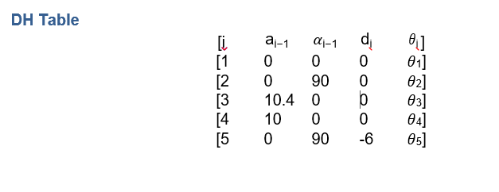
INTRODUCTION
1/7
ROT3U is a 6 DOF robot with the following specifications
  Rotation angle of 180 degrees
  Height: 460mm (holder closed)
  Holder of the widest distance: 98mm
  DH table of ROT3U is as follows
ROT3U Application

Slide 2
Application outline
2/7
ROT3U will be used for writing
Proof of concept will involve writing a character
Letter will be detected by camera of laptop
Letter written will be identified by neural network
ROT3U Application

Slide 3
APP DEV…ROT3U MOVEMENT
3/7
Selection of points to write a word “T” in ROT3U
Proof of concept involved only writing one word (T)
Selection of 4 points in space
Those 4 points were measured from base of robot
Using inverse Kinematics angles for those points were calculated
Those angles were fed into Arduino code
ROT3U motors moved as per angles given
ROT3U Application

Slide 4
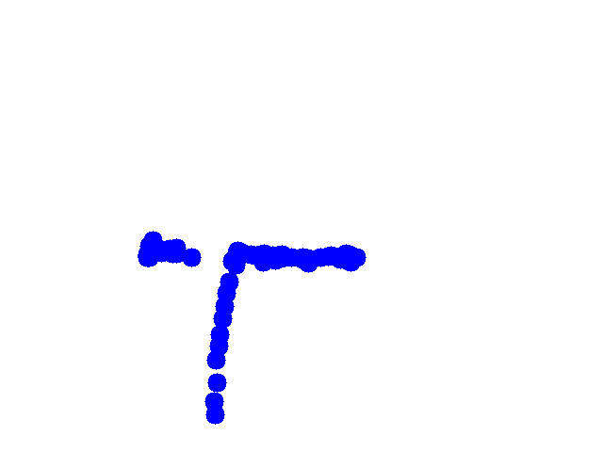
APP DEV…Contour DETECTION
4/7
An object having blue color was fixed in end effector
End Effector position having blue color was tracked
Using openCV blue object was tracked
Using HSV mask blue color was identified
After identification of blue color contour was drawn on canvas
Later on drawn contour points were saved and taken in form of image
Drawn points were made against white background
ROT3U Application

Slide 5
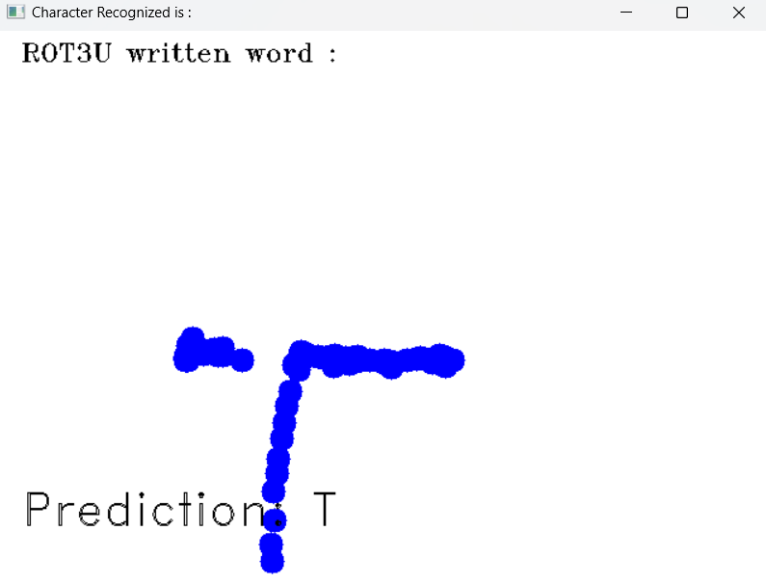
APP DEV…NEURAL NETWORK
5/7
Neural network was trained on open dataset EMNIST having alphabets
Sequential Model was used consisting of 3 Convolution layers
Input shape (28,28,1) was used
Different filters (32,64,128) were learned using network
Activation function RELU was used
Model accuracy came out to be above 92%
Image captured by openCV having contours was fed into CNN
It detected the letter “T”
ROT3U Application

